Slide 1

Machine Learning Based Personality Classification Using K-Means Clustering Algorithm
Submitted in partial fulfilment for the award of the degree of
Bachelor of Technology
in
ELECTRONICS AND COMMUNICATION ENGINEERING
Submitted by:
17BTREC108 | Sumukha A
17BTREC006 | Sai Ritwik Reddy K
Batch No. Batch 2017-21/AY 2020-21/B7
Date of Presentation: 04/06/2021
Dr. Manjula TR
Assistant Professor
Department of Electronics and Communication Engineering
Faculty of Engineering and Technology
JAIN DEEMED-TO-BE UNIVERSITY

Slide 2

Content
Introduction
Literature Survey
Problem Definition
Objectives
About the Dataset
Dataset Sample
Questions Sample
Methodology
Development-Software
Performance Analysis in Simulation
Limitations and Applications
Conclusion and Future Scope
References

Slide 3
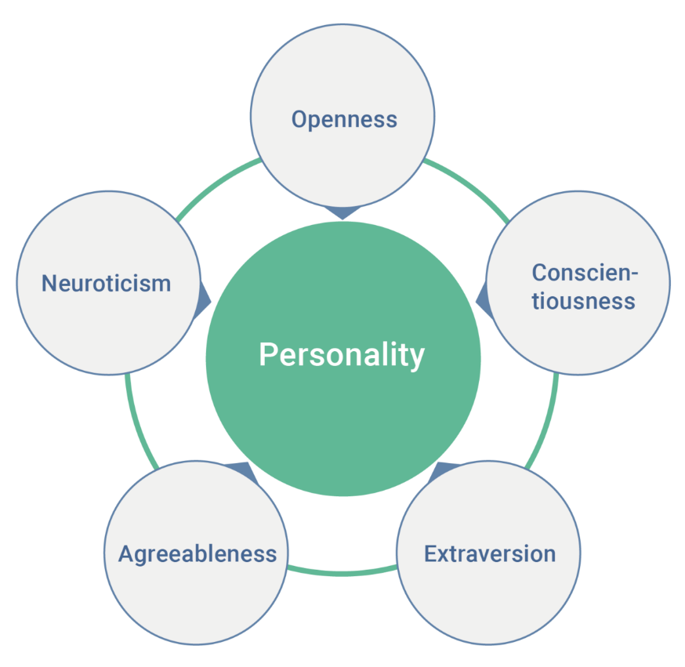
Introduction
This project aims to classify the personality of a participant with the help of their answers to certain questions, based on Big Five model.
Openness – imagination and insight
Conscientiousness – thoughtful, organized and mindful
Extraversion – excitability, sociability, talkative, expressive
Agreeableness – trust, kindness, affection
Neuroticism- sadness, moodiness, anxiety
Image source: wikipedia.org

Slide 4
Literature Survey
“2021, Personality-Aware Product Recommendation System Based on User Interests Mining and Metapath Discovery”
This is recommendation system that uses personality prediction with buying history, it showed significant improvement compared to legacy recommendation system especially in cold-start settings.
“2020, Automatic personality learning using students’ online learning behavior”.
Uses Enhanced extended nearest neighbor(EENN) to automatically identify two of the Big Five personality traits from student’s behavior in online learning.
“2020, Personality Dimensions Classification with EEG Analysis using Support Vector Machine”.
Uses electroencephalography (EEG) to classify personality dimensions. The classification was performed using support vector machine (SVM) to determine personality dimensions.
“2018, Using Classification to Determine Whether Personality Profiles of Countries Affect Various National Indexes”
Focuses on individuals of a nation using dataset based on MBIT (Myers-Briggs Type Indicator) and determine whether personality affects various national indexes.

Slide 5
Problem Definition
One’s personality is closely related to one’s job performance and career choices.
One of the factors to be considered while recruiting is the candidate’s personality, considering the best out of all the applicants will be the major concern for the recruiter.
When a person is looking forward to make career choices, one of the important factors to be considered is the person’s personality, understanding oneself is important when it comes to making good career choices.
One of the factors to be considered while estimating the success of a product by a company is the dominant consumer personality of a geographical region.

Slide 6
Objectives
Classify the participants based on their geographical location.
Classifying the new participants to existing personality pattern groups.
It shows the top participants with highest scores in a particular personality trait.

Slide 7
About the Dataset
The dataset was downloaded from kaggle.
This data was collected through an interactive on-line personality test.
Participants were informed that their responses would be recorded and used for research at the beginning of the test, and asked to confirm their consent at the end of the test.
Participant had to rate from 1 to 5 1=Disagree, 3=Neutral, 5=Agree
Structure of the questions:
Openness – 10 questions
Conscientiousness – 10 questions
Extraversion – 10 questions
Agreeableness – 10 questions
Neuroticism _ 10 questions
Total of 50 questions

Slide 8
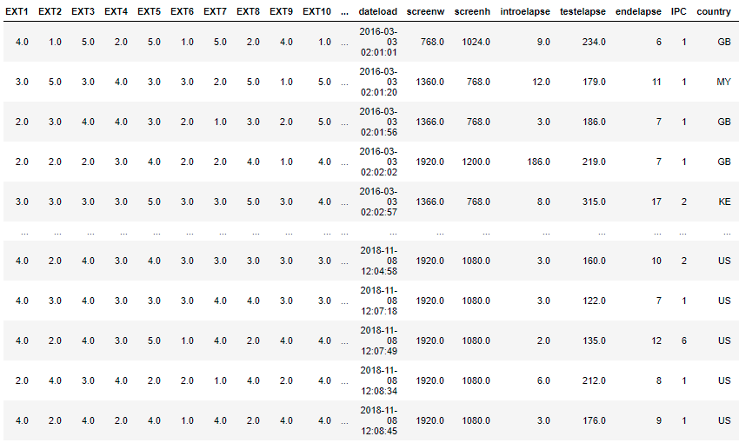
Dataset Sample

Slide 9
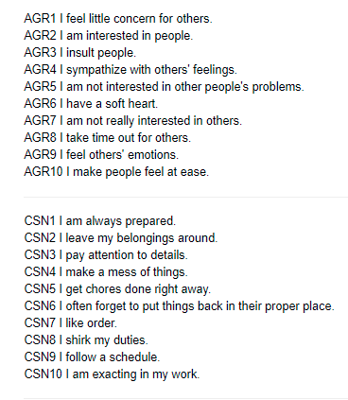
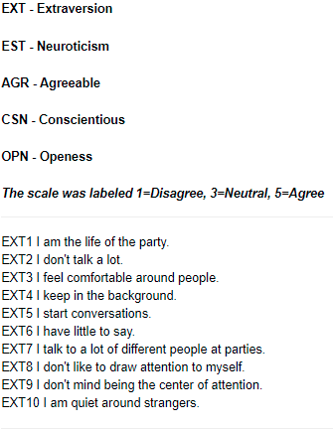
Questions Sample

Slide 10
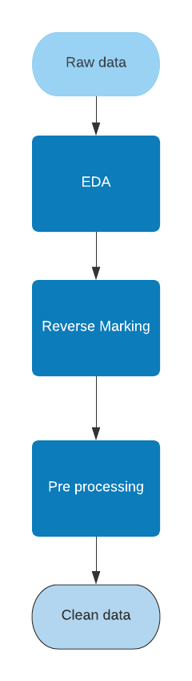
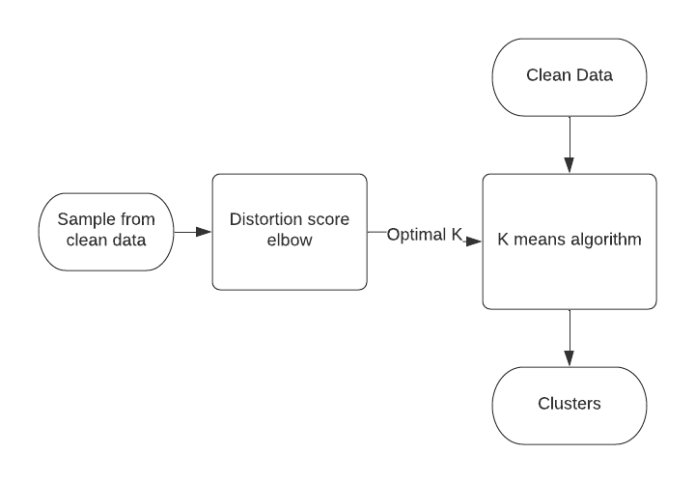
Methodology
Cleaning Dataset
Getting Clusters

Slide 11
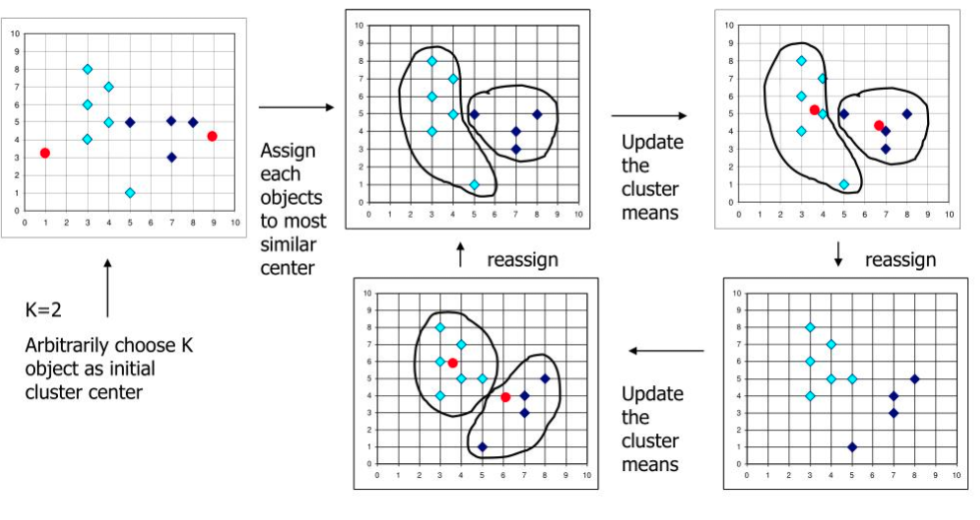
Methodology
Working of K Means algorithm

Slide 12



Development-Software
IDE – Jupyter Notebook
A notebook integrates code and its output into a single document that combines visualizations, narrative text, mathematical equations, and other rich media.
Anaconda
Anaconda is a free and open-source distribution of the programming languages Python and R. The distribution comes with the Python interpreter and various packages related to machine learning and data science.
Programing language – Python 3.8.5
Python is an interpreted, object-oriented, high-level programming language with dynamic semantics. Its high-level built in data structures, combined with dynamic typing.

Slide 13
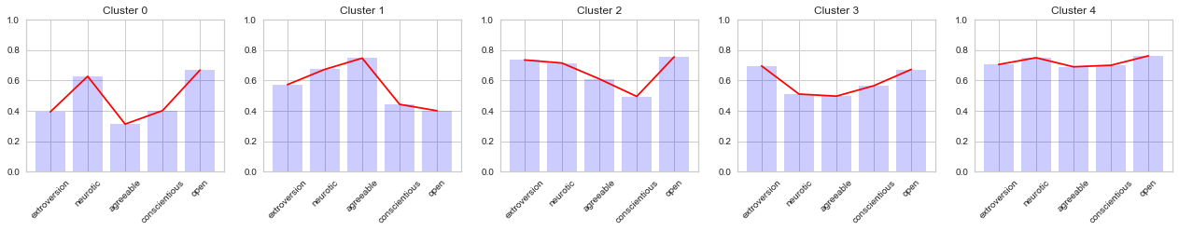
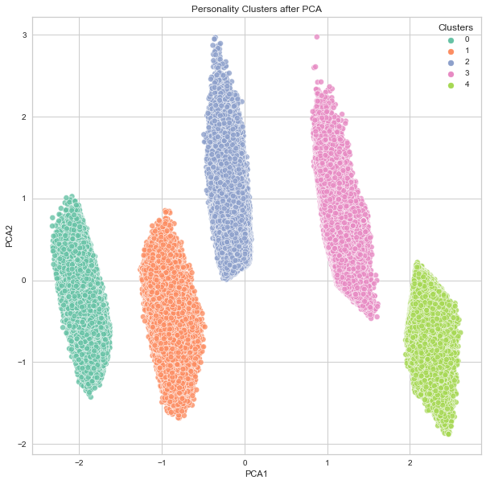
Performance Analysis in Simulation
Individual Clusters
Data Clusters

Slide 14
Performance Analysis in Simulation
What happens in K-means for this data?
When we apply K-means algorithm to our data, it identifies groups (5 groups in this case)
Data in a group is similar to all the data in that group and vice versa.
Why clustering the data?
To visualize which country has what pattern of personality traits.
What inference can be drawn from these clusters?
A participant belonging to cluster x, exhibits certain pattern of personality traits, this pattern is close to the pattern represented by that cluster x.

Slide 15
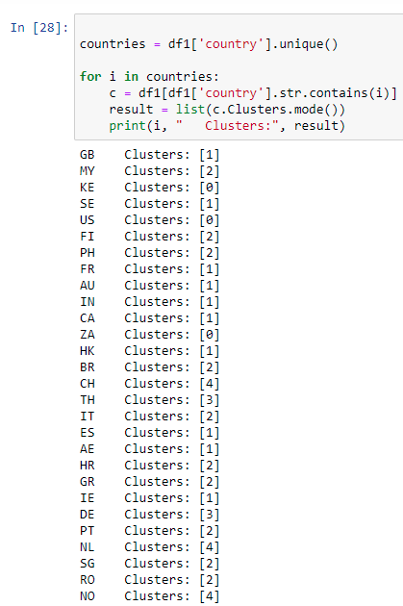
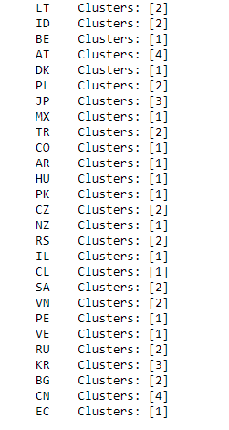
Performance Analysis in Simulation
Country based dominant personality

Slide 16
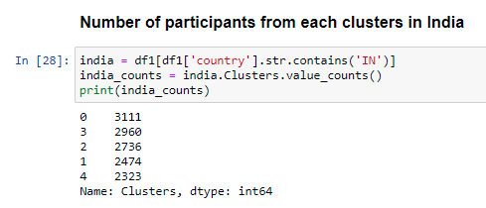
Performance Analysis in Simulation

Slide 17
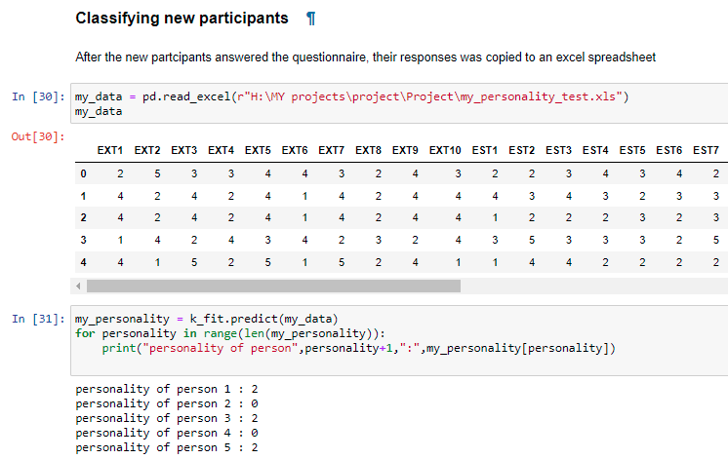
Performance Analysis in Simulation

Slide 18
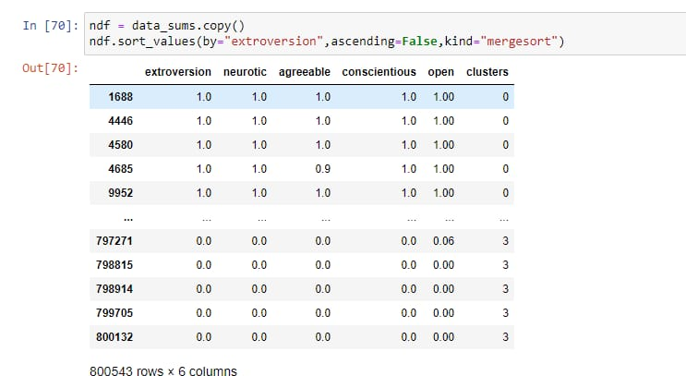
Performance Analysis in Simulation

Slide 19
Limitations and Applications
Limitations:
As the questionnaires ask personal questions, very few people are willing to share their data to the public(educational use), which results in scarcity of practical datasets.
The dominant geographic location based personality is directly proportional to number of participants (i.e. less participants = less generalized result).
Application:
It can be used by recruiters to find top scorers in a specific personality trait.
It can be used by company to estimate the success of a product based on consumer’s personalities.
It can be used by career councilors to understand the personality of a candidate and recommend career paths based on it.

Slide 20
Conclusion and Future Scope
Conclusion:
In this project we saw how clustering algorithm can be used to cluster the data.
We saw how the clusters can be used to find the dominant personality of a country.
We also saw how we can find our personality by answering the questions provided in the questionnaire.
Future Scope:
Can be used by recommendation system to display accurate recommendations even without consumer’s order history.
Can be used by teachers to find the optimal methods of teaching by analyzing the pupil’s personalities.

Slide 21
References
Dataset: https://www.kaggle.com/tunguz/big-five-personality-test
Big five Markers: https://ipip.ori.org/newBigFive5broadKey.htm
Research Papers:
https://ieeexplore.ieee.org/document/9269396
https://ieeexplore.ieee.org/document/8744258/
https://ieeexplore.ieee.org/document/9315507/
https://ieeexplore.ieee.org/document/8698401/
Documentations of packages used:
Kmeans – https://medium.com/data-folks-indonesia/step-by-step-to-understanding-k-means-clustering-and-implementation-with-sklearn-b55803f519d6
KElbowVisualizer- https://www.scikit-yb.org/en/latest/api/cluster/elbow.html#:~:text=The%20elbow%20method%20runs%20k,point%20to%20its%20assigned%20center
https://scikit-learn.org/stable/modules/generated/sklearn.cluster.KMeans.html
PCA – https://towardsdatascience.com/understanding-pca-fae3e243731d
https://nbviewer.jupyter.org/gist/sevamoo/f1afe78af3cf6b8c4b67
https://glowingpython.blogspot.com/2013/09/self-organizing-maps.html

